Slide 1

Movie Performance Analysis
Presenter: Sumali Wickramarachchi
11th August 2023
Notes:
Speaker Notes: my name is Sumali, I will walk through key things to consider when deciding a new studio venture

Slide 2

Business Problem
How can Microsoft take better informed decisions on deciding where to Invest.
Is it organic growth or acquisition works better?
Which gernes works best?
How do customers feel about movies made ?
How well competitors are performing ?
How can we keep it profitable?
Notes:
. Slide 1
Investing in a new studio and moving to a industry is a big decision. Through this presentation I will help to guide to take data driven decisions I have analysed historical box office performance of titles & studios to direct you take better investment decisions.
To do this gathering, processing, and interpreting data to gain insights into various aspects of the film industry's performance. It takes into account approximately 145,000 movies and 260 studios within the timeframe of 2010 to 2018.

Slide 3
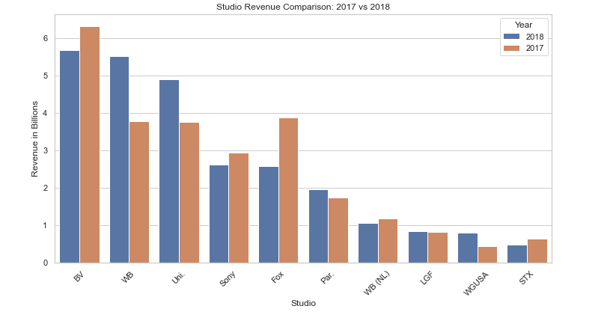
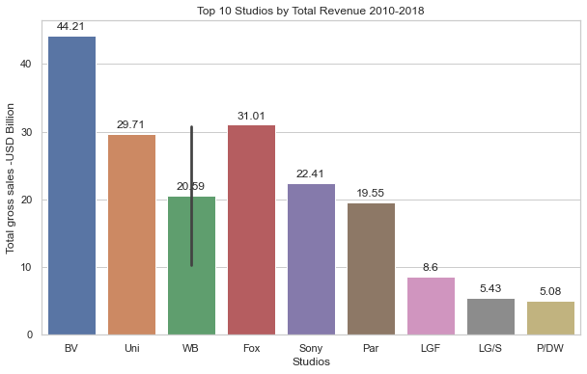
Market leaders
Conversely, BV's revenue witnessed a significant decrease of 10%, indicating a potential area for improvement
Industry leaders BV, Fox, Sony & Uni continue to be all time market leaders
WB (46% vs YoY), Uni (30% vs YoY) reported double digit growth
Disclaimer: Box office Gross earnings illustrates 3400 movies during 2015-2018 period.
Notes:
Slide 3
BV (Buena Vista)
#Gross profit has increased up to 2 billion in 2018 which shows opportunity to grow in the industry.
I have analysed ones with the highest revenue potential by limiting to box office records for better ROI potential for investors. Box office records drop by 25% during 2017 to 2018.This can be due to economic factors, competition from streaming services & changing viewing habits

Slide 4
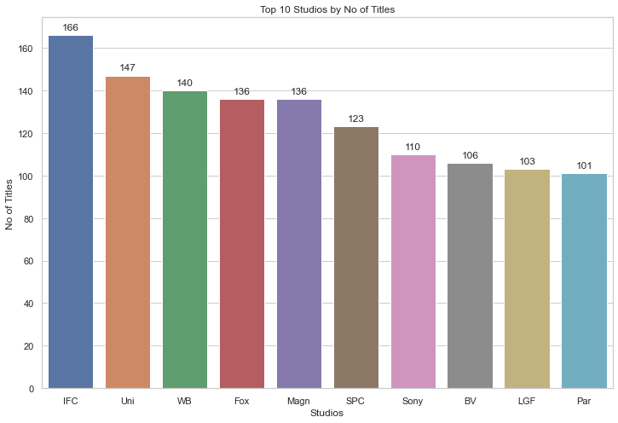
Emphasize Excellence Over Quantity: Prioritize Movie Quality
Whilst IFC generated 166 titles, market leader (revenue wise) gravitate towards BV, Uni & WB
Approximately out of all movies produced only 2% of movies made it to a box office record
Disclaimer: Box office Gross earnings illustrates 3400 movies during 2015-2018 period.
Notes:
Success is not about how many titles created. It’s about quality of content.
By adopting a multidimensional approach that combines data analysis, audience engagement, strategic partnerships, and continuous innovation, Microsoft's movie studio can make well-informed decisions that drive success, profitability, and enduring audience satisfaction.

Slide 5

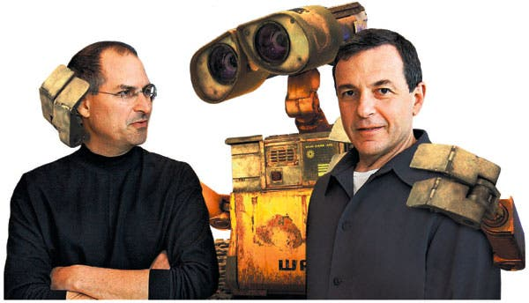
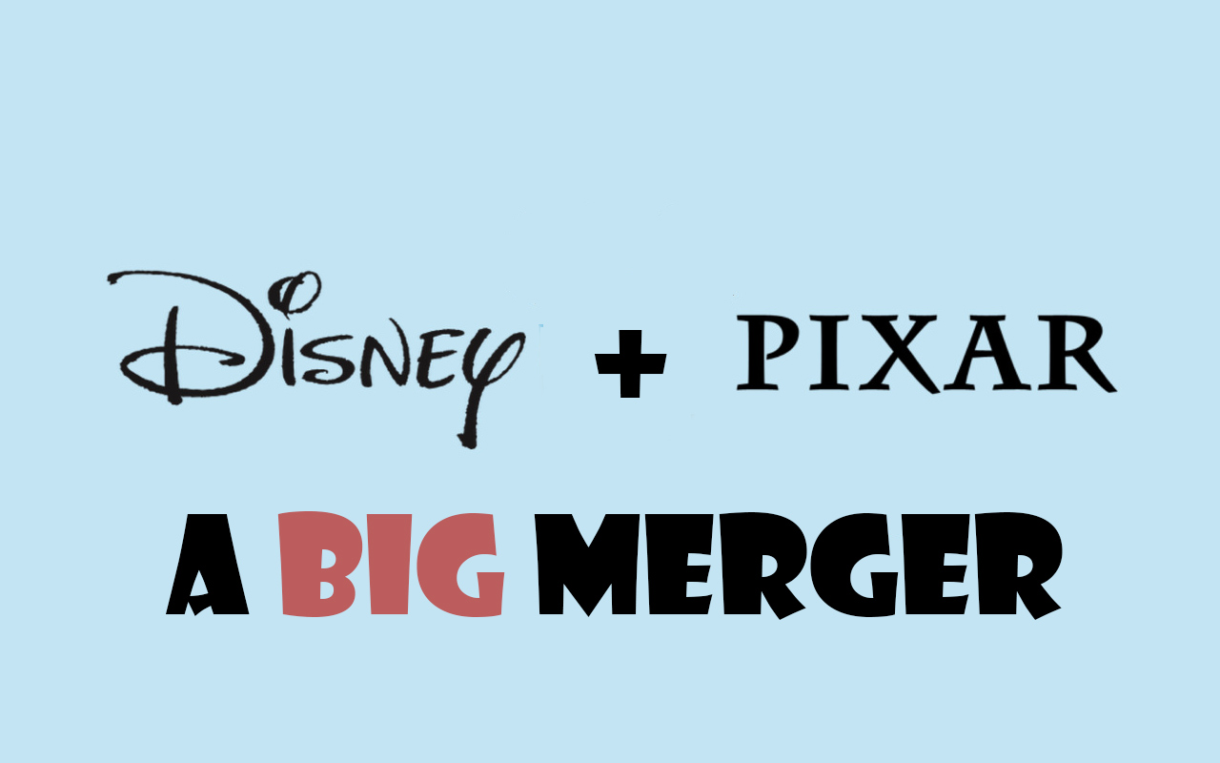
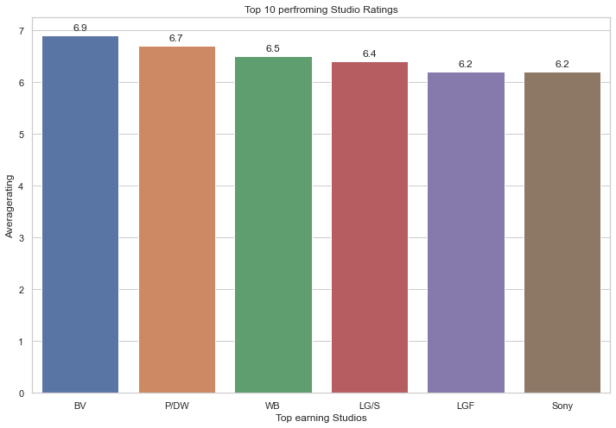
Hear the customer
When it comes to movie ratings, BV emerges as a standout performer
Time taken to build a sort after studio can take up to 12+ years.
Votes: WB, BV, Fox, Uni, Par, and Sony shine as the preferred choices for individuals provide valuable feedback to improve future Studio content.
Notes:
Slide 5
Speaker Notes:
First statement refers no of votes by a studio.
When it comes to movie ratings, BV emerges as a standout performer with an impressive average rating of 6.9. Following closely, P/DW and W/B These ratings not only surpass the industry's average but also reflect the elevated satisfaction levels that audiences experience with the captivating and engaging content produced by these studios.
Time taken to build a sort after studio can take up to 12 years. Initial Establishment (1-2 Years), Content Creation and Release (2-5 Years), Audience Engagement and Loyalty (3-7 Years), Industry Recognition and Partnerships (8-12 Years), Legacy and Continued Growth (10+ Years) .
BV (Buena Vista) is a distribution brand that is associated with Disney's distribution and marketing efforts for its films.
Disney purchased Pixar in 2006 for approximately $7.4 billion. Walt Disney wanted to marry the style of their previous films with the exceptional storytelling techniques of Pixar. The merger of Walt Disney and Pixar was among the most successful corporate transactions in recent years.

Slide 6
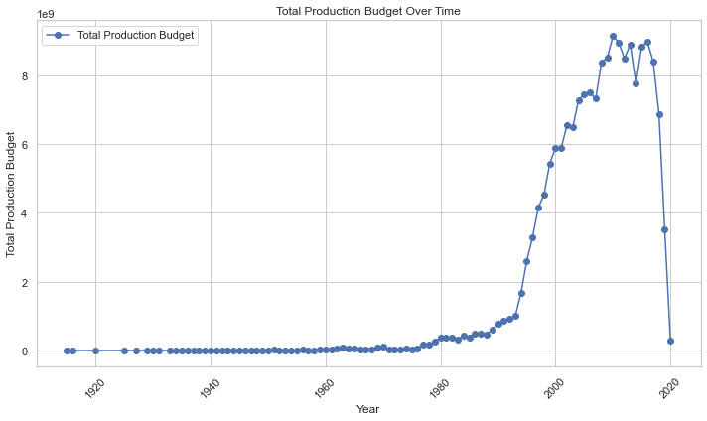
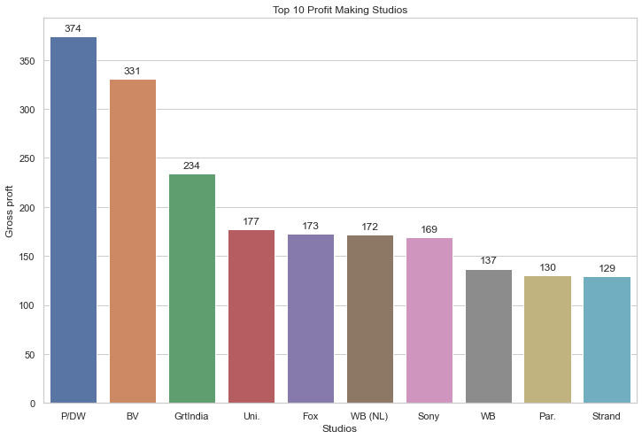
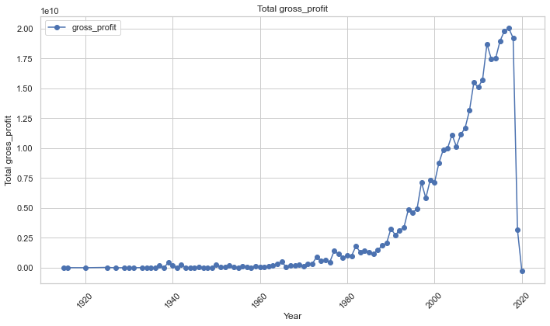
Operational Excellence
In recent years production costs surging to a remarkable 8 billion in 2018 & gross profit to USD 2 billion
P/D W takes the lead followed by BV and Girt India in gross profitability
Notes:
Industry Performance & Profitability: In recent years production costs surging to a remarkable 8 billion in 2018 & gross profit to 2 billion. This substantial increase underscores the industry's resilience and potential for further growth as a star industry.
Within this dynamic landscape, PD/W takes the lead, garnering an impressive 374 million in earnings. Following suit, BV secures a notable 331 million, while Grit India follows closely with 234 million. WB stands at notable 137 million.
Studies shows it will take at least 12 years to acquire maturity in the industry to generate postive NPV/ ROI creating own content/ studio without right partnerships often challenging.

Slide 7
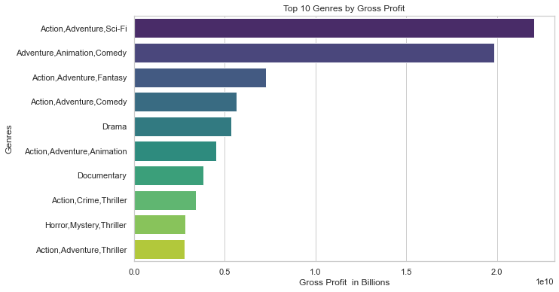
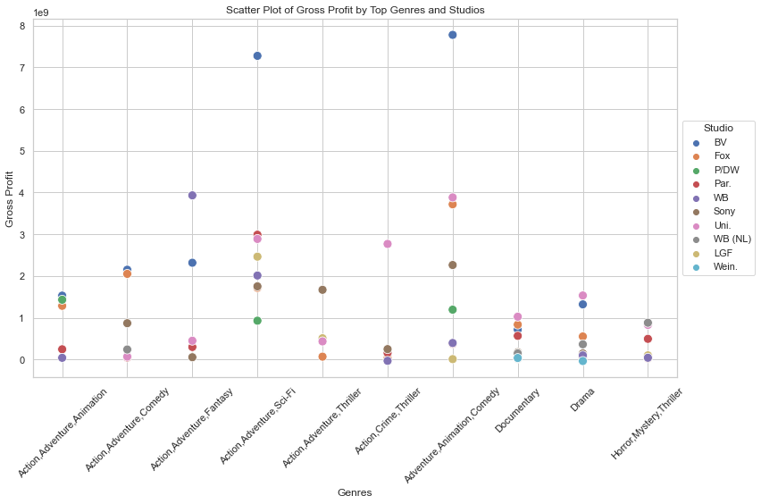
Genres Analysis
Profitable Genres: Action, Adventure, Sci-Fi, Animation, Comedy, Fantasy, and Drama rise as the major contributors for revenue in the industry.
BV seem have a distinguished presence in Adventure, Animation, Comedy, Action, Adventuress-Fis. WB seem to thrive Fantasy Genre along with Adventure.
.

Slide 8
Conclusion
1. Instead of organic growth focus on merge & acquisition: Expanding on successful studios or adapting well-known intellectual properties (IPs) can attract dedicated fan bases, consistent revenue guaranteed contribution to box office triumphs & return on investment (ROI) .
2. Genre Analysis: Action Adventure with thrilling narrative and experience, animation alluring creativity & heartfelt stories, Fantasy transport viewers to imaginations are common consistently draw large crowds and drive box office success hence focusing on these genres can create more revenue.
3. Better budget planning - Reduce increasing product budgets by introducing new green production techniques driven solutions, better resource management, cost effective equipment and adjusting Crew Size and Skill Mix without compromising on the quality and artistic vision of the project budgets:
Next Steps- Additional Analysis
Notes:
Slide 8
Recommendation 1: In relation to studio Acquisition focus on Studio BV as first choice followed by WB. BV has more market share (both recent & passed), better customer perception & profitable. WB has same potential but operating slightly smaller scale to BV depending on acquisition budget it would be good second choice.
Recommendation 2: Consider investing more on Action, Adventure, Sci-Fi, Adventure, Animation, Comedy & Drama genres as they can become more profitable and have more revenue generating potential.
Recommendation 2: Microsoft can bring synergistic benefits to reduce increasing product budgets by introducing new green production techniques driven solutions, better resource management, cost effective equipment and adjusting Crew Size and Skill Mix without compromising on the quality and artistic vision of the project .
I would strong advice to Evaluate the benefits of organic growth (creating original content) versus acquisitions (acquiring existing studios). Consider factors like time-to-market, creative control, cost-efficiency, and leveraging established brands.
What also will be useful if you interested would be
As part of the analysis, we have not considered other factors that can create a profound impact on studios such as digital and home entertainment, critic reviews, demographics & geographics of consumers, academy awards & nominees. Including most recent data relate to 2019-2022 (post pandemic) and analysing consumer sentiments would further elevate this study's findings. That can be the next phase.

Slide 9


Thank you
Sumali Wickramarachchi
sumaliwick11@gmail.com
GitHub: @SumaliWick
LinkedIn profile: Sumali Wickramarachchi
https://www.linkedin.com/in/sumali-wickramarachchi-3a296356/

